Slide 1
Doctors believes that the average teen sleeps on average no longer than 10 hours per day
A company has started that their straw machine makes straws that are 4 mm diameter. A worker believes that the machine no longer makes straw of 4 mm diameter
The school board claims that at least 60% of students bring a phone to school

Slide 2
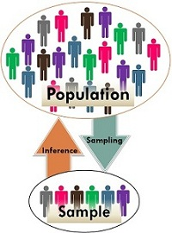
Inferential Statistics
It allows you to make inferences from that data. With inferential statistics, you take data from sample and make generalizations about a population.
For example, you might stand in a mall and ask a sample of 100 people if they like shopping at Levis.
You could make a bar chart of yes or no answers (that would be descriptive statistics) of the population (all shoppers in all malls)
Or you could use inferential statistics to reason that around 75-80% of the population like shopping at Levis taking multiple samples.
Hypothesis Testing

Slide 3
Introduction
Hypothesis testing is a kind of statistical inference that involves asking a question, collecting data, and then examining what the data tells us about how to proceed.
Hypothesis test is a statistical procedure that’s designed to test a claim.
Typically the claim is being made about a population
For example, the claim that 25% of all men are smokers is a claim about the proportion(that’s a parameter) of all men(that’s a population) who smoke.

Slide 4
Null and Alternative Hypothesis
The hypothesis to be tested is called the null hypothesis and given the symbol H0.
The null hypothesis states that there is no difference between a hypothesized population mean and a sample mean. It is the status quo hypothesis.
We test the null hypothesis against an alternative hypothesis, which is given the symbol Ha. The alternative hypothesis is often the hypothesis that you believe yourself!
alternative hypothesis includes the outcomes not covered by the null hypothesis

Slide 5

We have a medicine that is being manufactured and each pill is supposed to have 14 milligrams of the active ingredient. What are our null and alternative hypotheses?

Slide 6
A package of mint gum claims that the flavor lasts more than 39 minutes. What would be the null hypothesis of a test to determine the validity of the claim?
H0>= 39
HA<39

Slide 7
A researcher claims that black horses are, on average, more than 30 lbs heavier than white horses, which average 1100 lbs. What is the null hypothesis
H0 : μ <= 1130 lbs
HA: μ>1130

Slide 8
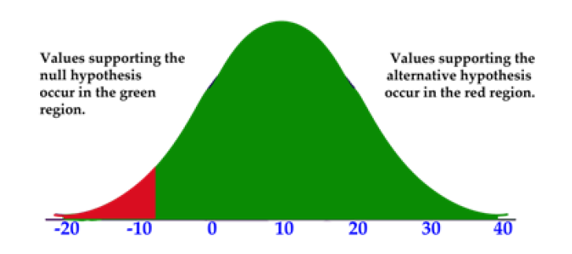
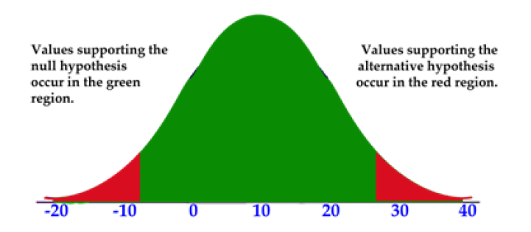
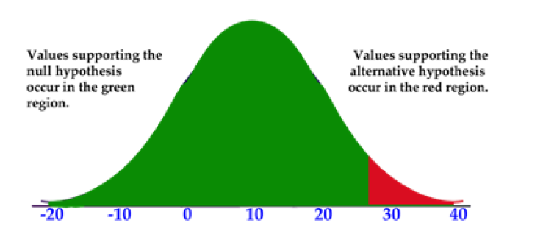
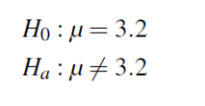
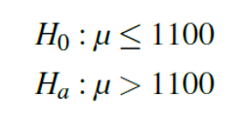

Hypothesis Tests and Their Tails
Lower/left tailed
two tailed
upper/right tailed

Slide 9
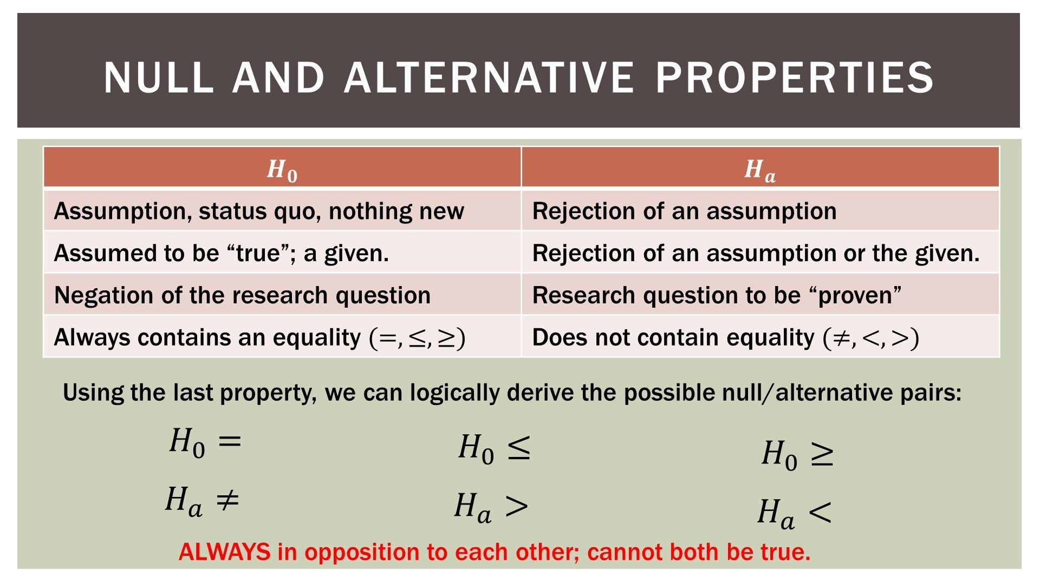

Slide 10
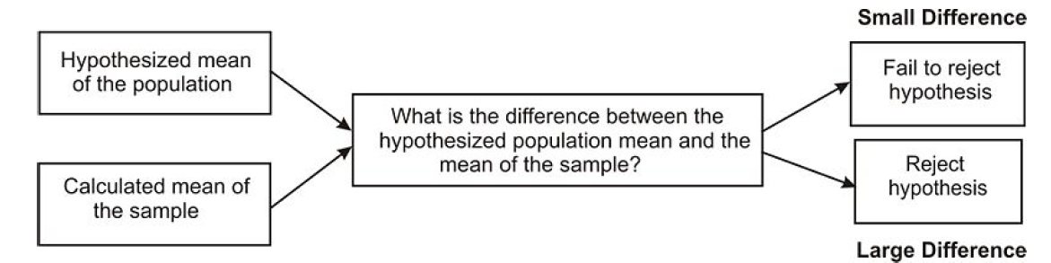
Deciding Whether to Reject the Null Hypothesis:
The alternative hypothesis can be supported only by rejecting the null hypothesis.
To reject the null hypothesis means to find a large enough difference between your sample mean and the hypothesized (null) mean.

Slide 11
When a hypothesis is tested, a statistician must decide on how much of a difference between means is necessary in order to reject the null hypothesis.
Statisticians choose a level of significance or alpha level for their hypothesis test.
An alpha level of 0.05 means that we will consider our sample mean to be significantly different from the hypothesized mean if the chances of observing that sample mean are less than 5%.
Similarly, an alpha level of 0.01 means that we will consider our sample mean to be significantly different from the hypothesized mean if the chances of observing that sample mean are less than 1%.

Slide 12
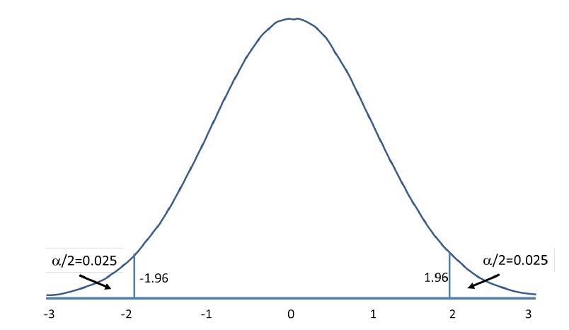
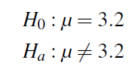
Two-tailed Hypothesis Tests
In a two-tailed test, we reject the null hypothesis if sample mean falls in either tail of the distribution.
The alpha level (let’s assume .05) is split across the two tails. The curve shows the critical regions for a two-tailed test.
These are the regions under the normal curve that, together, sum to a probability of 0.05. Each tail has a probability of 0.025. The z-scores that designate the start of the critical region are called the critical values

Slide 13
If the sample mean taken from the population falls within these critical regions, or "rejection regions," we would conclude that there was too much of a difference and we would reject the null hypothesis.
However, if the mean from the sample falls in the middle of the distribution (in between the critical regions) we would fail to reject the null hypothesis.

Slide 14

One-Tailed Hypothesis Test
We would use a single-tail hypothesis test when the direction of the results is anticipated or we are only interested in one direction of the results.
Claiming that the average SAT score of graduating seniors was GREATER than 1,110

Slide 15
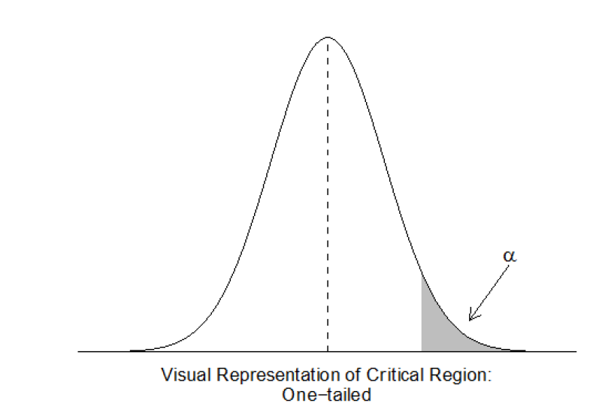
we have only one critical region because we put the entire critical region into just one side of the distribution.
When the alternative hypothesis is that the sample mean is greater, the critical region is on the right side of the distribution (see below).
When the alternative hypothesis is that the sample mean is smaller, the critical region is on the left side of the distribution.

Slide 16
An ice pack claims to stay cold between 35 and 65 minutes. What would be the null hypothesis
H0 : 35<=cold<=65

Slide 17
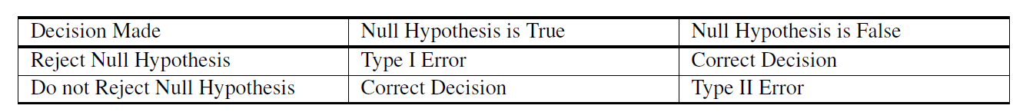
Type I and Type II Errors
Type I Error – Type I error occurs when the researcher rejects a null hypothesis when it is true. The term significance level is used to express the probability of Type I error while testing hypothesis. The significance level is represented by the symbol α(alpha).
Type II Error – Accepting a false null hypothesis H₀ is referred as the Type II error. The term power of the test is used to express the probability of Type II error while testing hypothesis. The power of the test is represented by the symbol β(beta).

Slide 18
General Steps of Hypothesis Testing
1. State the null and alternative hypotheses.
2. Select the appropriate significance level and check the test assumptions.
3. Analyze the data and compute the test statistic.
4. Interpret the result

Slide 19
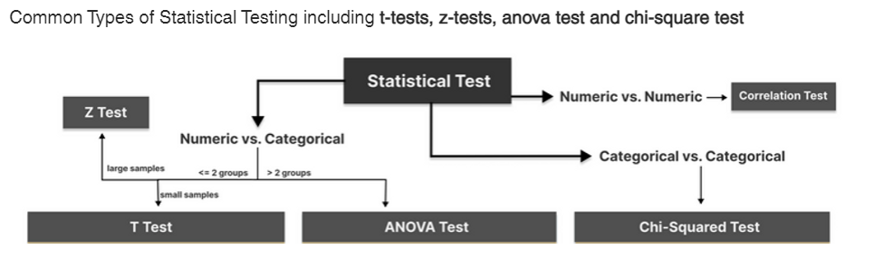

Slide 20
One Sample Mean When the Population Parameters are Known
We find the z-statistic of our sample mean in the sampling distribution and determine if that z-score falls within the critical (rejection) region or not.
This test is only appropriate when you know the true mean and standard deviation of the population.

Slide 21
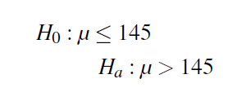
The school nurse thinks the average height of 7th graders has increased. The average height of a 7th grader five years ago was 145 cm with a standard deviation of 20 cm.
She takes a random sample of 200 students and finds that the average height of her sample is 147 cm. Are 7th graders now taller than they were before? Conduct a single-tailed hypothesis test using a .05 significance level to evaluate the null and alternative hypotheses.

Slide 22
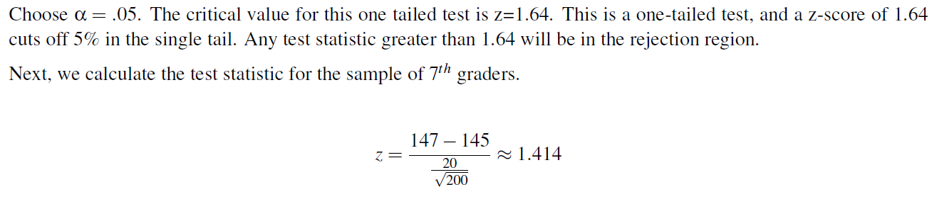

Slide 23
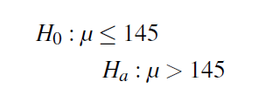
A farmer is trying out a planting technique that he hopes will increase the yield on his pea plants. The average number of pods on one of his pea plants is 145 pods with a standard deviation of 100 pods.
This year, after trying his new planting technique, he takes a random sample of his plants and finds the average number of pods to be 147.
He wonders whether or not this is a statistically significant increase. What are his hypotheses and the test statistic?

Slide 24
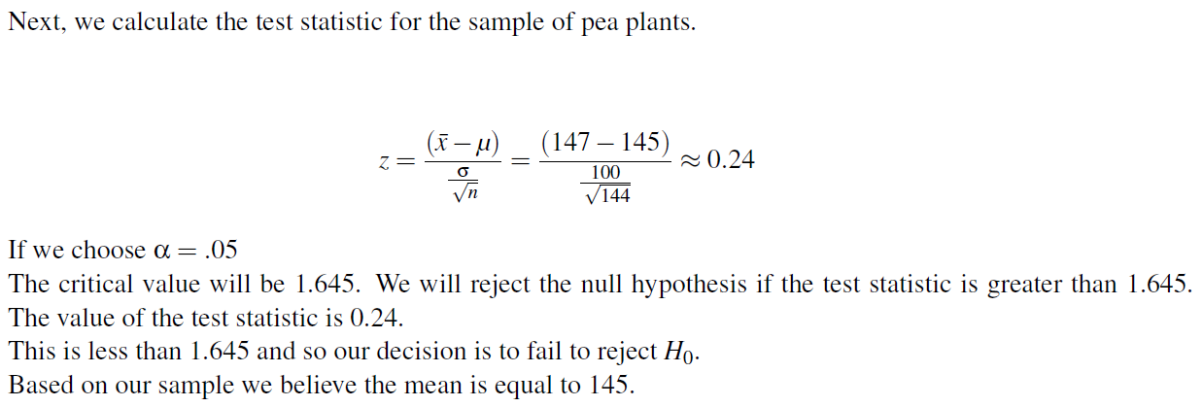

Slide 25
Reporting P-Values as an Alternative to Looking at Critical Regions
We can also evaluate a hypothesis by asking, “What is the probability of obtaining the value of the test statistic, if the null hypothesis is true?” This is called the pvalue.

Slide 26
Interpreting a p- value
To make a proper decision about whether or not to reject H₀ , you determine your cutoff probability for your p- value before doing a hypothesis test; this cut off is called an alpha level (α)
If p value is greater than or equal to α, you fail to reject H₀
If p value is less than α, you reject H₀

Slide 27
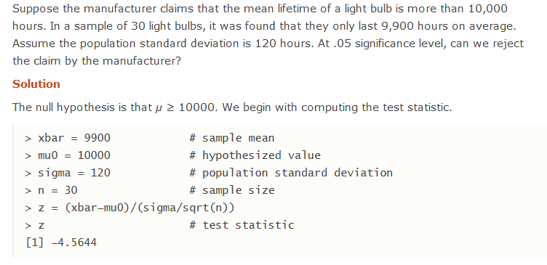
Notes:
http://www.r-tutor.com/elementary-statistics/hypothesis-testing/lower-tail-test-population-mean-known-variance

Slide 28
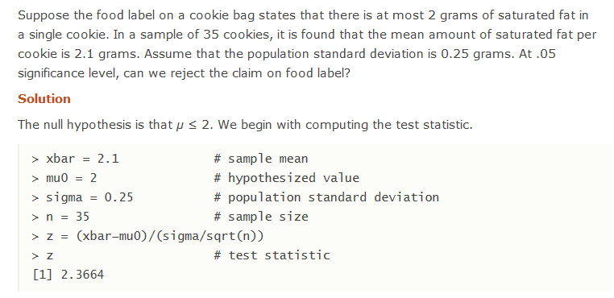

Slide 29
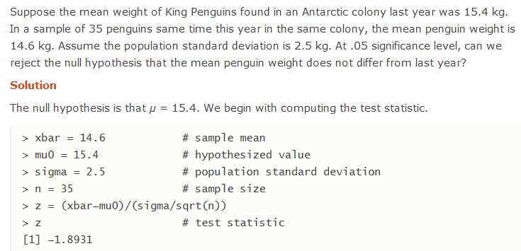
Notes:
http://www.r-tutor.com/elementary-statistics/hypothesis-testing/two-tailed-test-population-mean-known-variance

Slide 30
Hypothesis Tests When You Don’t Know Your Population Parameters
A z-test makes for an easy hypothesis test, but most of the time we can’t use it.
The reality is that most of our analyses are done when we don’t know what is true about a population.
When sample sizes changed, the shape of the distribution changed as well
Distributions for small sample sizes are now known as “Student’s t distributions.”

Slide 31
The Student’s t-distribution is similar to the normal distribution, except it is more spread out and wider in appearance, and has thicker tails.
As the number of observations gets larger, the t-distribution shape becomes more and more like the shape of the normal distribution.
In fact, if we had an infinite number of observations, the t distribution would perfectly match the normal distribution.
It is the t-distribution that allows us to test hypotheses when we don’t know the true population standard deviation

Slide 32
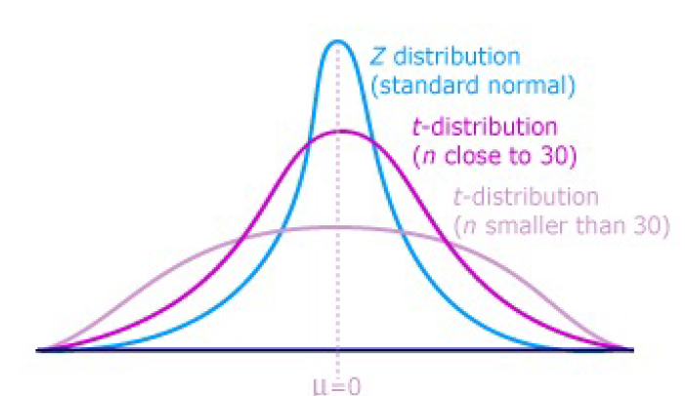

Slide 33

The differences between the t-distribution and the normal distribution are more exaggerated when there are fewer data points, and therefore fewer degrees of freedom.
Degrees of freedom are essentially the number of samples that have the ’freedom’ to change without affecting the sample mean. A

Slide 34
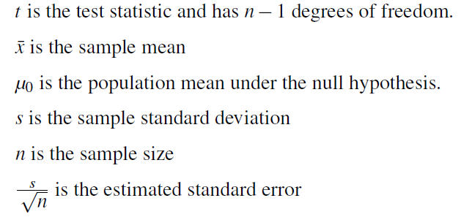

T-Test for One Sample Mean
We use the Student’s t distribution in hypothesis testing the same way that we use the normal distribution.
Each distribution is associated with a unique number of degrees of freedom (the number of observations minus one).

Slide 35
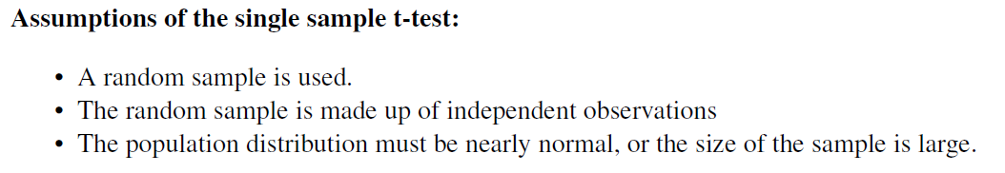

Slide 36
The high school athletic director is asked if football players are doing as well academically as the other student athletes. We know from a previous study that the average GPA for the student athletes is 3.10. After an initiative to help improve the GPA of student athletes, the athletic director randomly samples 20 football players and finds that the average GPA of the sample is 3.18 with a sample standard deviation of 0.54. Is there a significant improvement?
Use a 0.05 significance level.

Slide 37
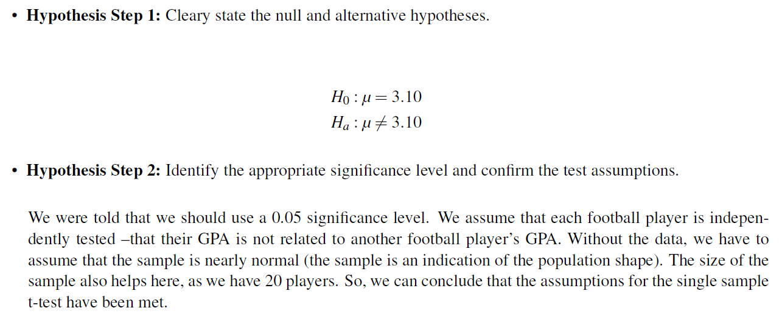

Slide 38
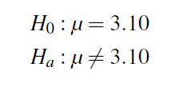
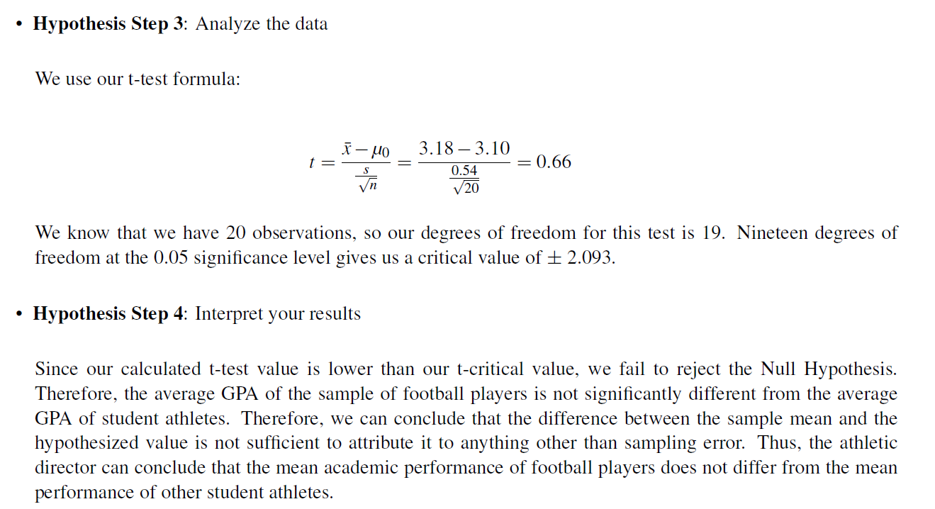

Slide 39
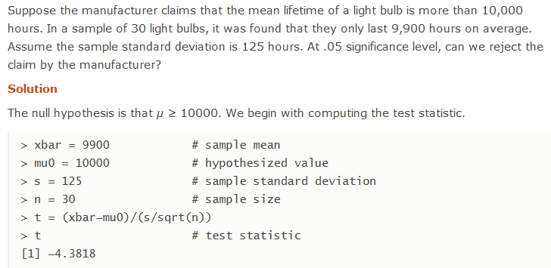

Slide 40
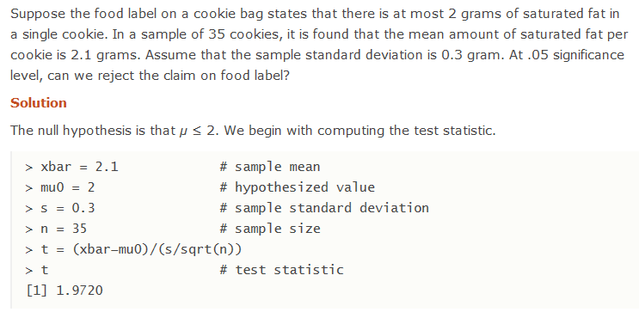

Slide 41
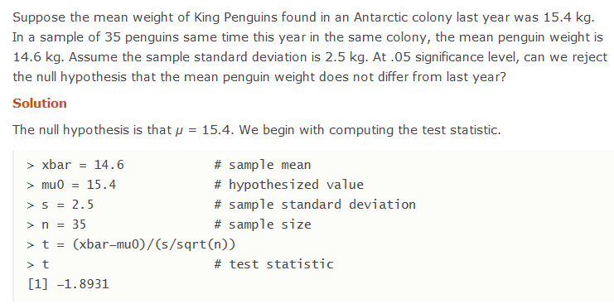

Slide 42
Duracell manufactures batteries that the CEO claims will last an average of 300 hours under normal use. A researcher randomly selected 20 batteries from the production line and tested these batteries. The tested batteries had a mean life span of 270 hours with a standard deviation of 50 hours. Do we have enough evidence to suggest that the claim of an average lifetime of 300 hours is false?

Slide 43
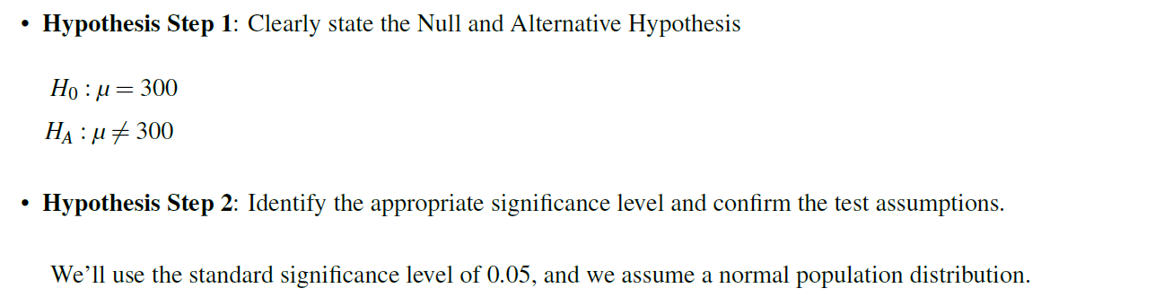

Slide 44
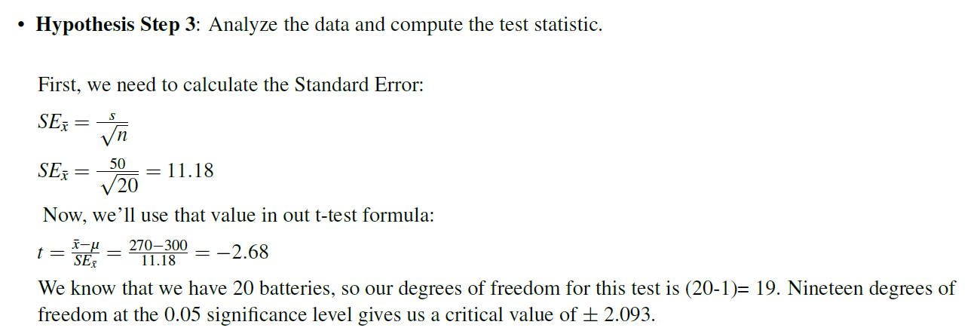

Slide 45
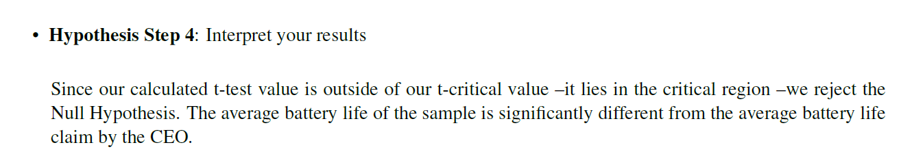

Slide 46
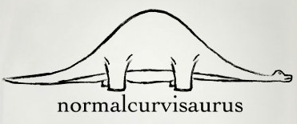
Hypothesis Testing Procedure
Set up the null and alternate hypothesis
Take a random sample of individuals from a population and calculate the sample statistics(means and S.D)
Convert the sample statistic to test statistic by changing it to a standard score(Z score)
Find the p value of your test statistic
Examine your p value and make our decision
Do you remember me???

Slide 47
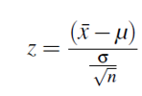

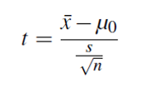
How to decide on test?
When the population standard deviation is known use z test
If unknown use t-test
T- test , we calculate degree of freedom (sample size-1)
T-test becomes similar to z-test if sample size increases
Notes:
https://stattrek.com/sampling/sampling-distribution.aspx

Slide 48
We wanted to test a hypothesis about the effect of two medications on curing an illness.
We may want to test the difference between the means of males and females on the spending in shopping

Slide 49
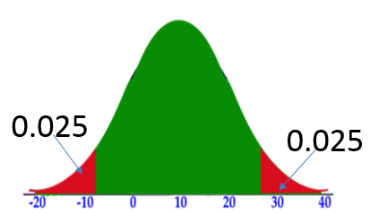
We may want to test the difference between the means of males and females on the spending in shopping
HA: Spending(men) != spending(women)
H0: Spending(men) == spending(women)
Two-sided

Slide 50
We may want to test the whether the means spending of males is greater than females on the spending in shopping
HA: spending(men)> spending(women)
H0: spending(men)<= spending(women)
One tail

Slide 51
Independent Samples
We assume that the scores of one sample do not affect the other
For example, suppose quality inspectors want to compare two laboratories to determine whether their blood tests give similar results.
They send blood samples drawn from the same 10 children to both labs for analysis.
Notes:
https://support.minitab.com/en-us/minitab/18/help-and-how-to/statistics/basic-statistics/supporting-topics/tests-of-means/what-are-independent-samples/

Slide 52


Testing Hypotheses with Independent Samples
The set up for the independent sample t-test is very similar to the single sample t-test.
hypotheses for the t-test, whether the means of two separate populations are equal
Similarly we can check whether one sample is greater and less than other sample/population.

Slide 53
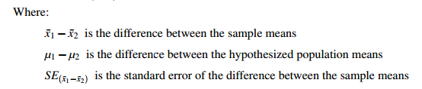

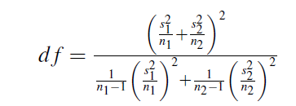


t-statistic formula

Slide 54
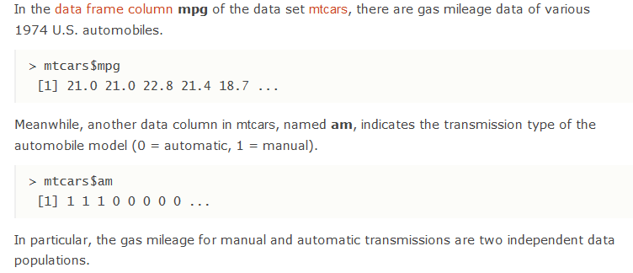

Slide 55
Dependent Samples
These types of samples are related to each other
In one, a group may be measured twice such as in a pretest-posttest situation (scores on a test before and after the lesson)
For example, you might have tested participants' eyesight when wearing two different types of spectacle.

Slide 56
Paired T-test
A math teacher wants to determine the effectiveness of her statistics lesson. She gives a simple skills test to nine students before the start of class (a pre-test) and the same skills test to the same students at the end of class (a post-test).

Slide 57
One Way Anova
There are many situations where you need to compare the mean between multiple groups.
For instance, the marketing department wants to know if three teams have the same sales performance.
Team: 3 level factor: A, B, and C
Sale: A measure of performance
The ANOVA test can tell if the three groups have similar performances.

Slide 58
Hypothesis in one-way ANOVA test
H0: The means between groups are identical
HA: At least, the mean of one group is different
Assumptions
We assume that each factor is randomly sampled, independent and comes from a normally distributed population with unknown but equal variances

Slide 59
Suppose a salesperson wants to compare the level of satisfaction of customers for four difference insurance companies.
Our question is:
"Is there a difference in satisfaction scores across the four difference insurance companies?”

Slide 60
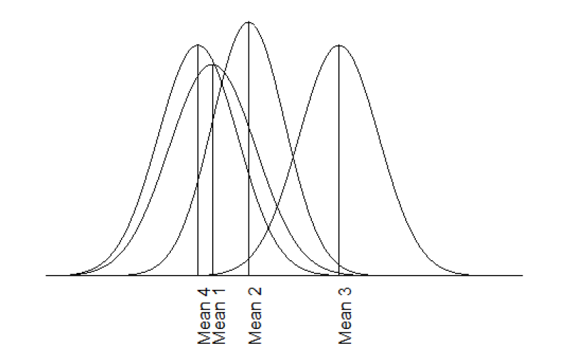

Slide 61
Chi-Square tests
In statistics, there are two different types of Chi-Square tests:
The Chi-Square Goodness of Fit Test – Used to determine whether or not a categorical variable follows a hypothesized distribution.
The Chi-Square Test of Independence – Used to determine whether or not there is a significant association between two categorical variables.
Notes:
https://www.statology.org/chi-square-test-real-life-examples/

Slide 62

Goodness-of-Fit Test
It is concerned with the distribution of one categorical variable.

Slide 63

degrees of freedom are found by taking the number of levels in our categorical variable and subtracting one.

Slide 64
The American Pet Products Association conducted a survey in 2011 and determined that 60% of dog owners have only one dog, 28% have two dogs, and 12% have three or more.
Supposing that you have decided to conduct your own survey to determine whether your data supports the results of the APPA study. Use a significance level of 0.05.
Data: Out of 129 dog owners, 73 had one dog and 38 had two dogs.

Slide 65



Slide 66
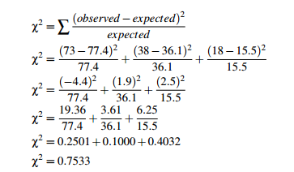

Slide 67
Now that we have our chi-square statistic, we need to compare it to the chi-square value for the significance level 0.05.
In this case, there are three category values: one dog, two dogs, and three or more dogs. The degrees for freedom, therefore, are 3−1 = 2.

Slide 68

Test of Independence

Slide 69
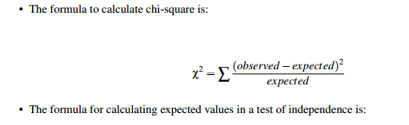

Where C is the observed column total for the cell, R is the observed row total for the cell, and n is the total number of samples.

Slide 70

The question here is whether gender affects tendency to take more photographs, or, in other words, are gender and photograph-taking tendency dependent?
Table with Actual and Expected value

Slide 71

Akash claims that single people prefer different pizzas than married people do. Akash’s brother doesn’t think that is true, so he conducts some research of his own, and collects the data below.
Notes:
https://www.mathsisfun.com/data/chi-square-test.html
https://onlinecourses.science.psu.edu/statprogram/reviews/statistical-concepts/chi-square-tests

